Slide 1
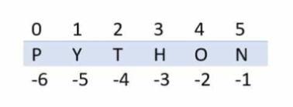
List In Python
Lists are used to store data in a single variable.
Lists in python is same as arrays , the only difference is arrays store only homogeneous type of elements (say all elements must only be integers , float , string) but in lists it stores heterogeneous type of elements.
Lists are mutable and indexed where index starts from zero.
Lists allow duplicates

